Slide 1
Introduction to OpenDSS
Roger Dugan Sr. Technical Executive
Davis Montenegro Engineer/Scientist III
NCSU OpenDSS Workshop Oct 25-26, 2018 Raleigh, NC

Slide 2

Instructor
Roger C. Dugan, Life Fellow, IEEE
Roger is a Sr. Technical Executive with EPRI in Knoxville, Tennessee USA. He has over 45 years of combined experience in distribution engineering with EPRI, Electrotek Concepts, and Cooper Power Systems. He holds the BSEE degree from Ohio University and the Master of Engineering in Electric Power Engineering degree from Rensselaer Polytechnic Institute, Troy, NY. Roger has worked on many diverse aspects of power engineering over his career because of his interests in applying computer methods to power system simulation. Beginning with a student internship with Columbus and Southern Ohio Electric Co, his work has been focused on Distribution Engineering. He was elected a Fellow of the IEEE for his contributions in harmonics and transients analysis. Recently, he has been very active in distributed generation, particularly as it applies to utility distribution systems and distribution system analysis. He was the 2005 recipient of the IEEE Excellence in Distribution Engineering Award. He is coauthor of Electrical Power Systems Quality published by McGraw-Hill, now in its 3rd edition. He serves on the IEEE PES Distribution System Analysis Subcommittee and is active in the Distribution Test Feeders WG.

Slide 3

Instructor
Davis Montenegro, Member, IEEE
Davis Montenegro-Martinez serves as Engineer/Scientist III at the Electric Power Research Institute (EPRI) in the areas of power system modeling, analysis and high performance computing. He received his degree in electronics engineering from Universidad Santo Tomás, Bogotá, Colombia (2004); he is M.Sc. in electrical engineering from Universidad de los Andes, Bogotá , Colombia (2012). He received his Ph.D. in electrical engineering from Universidad de los Andes (2015), and a Ph.D. in electrical engineering from the University Grenoble-Alpes, France (2015).
Before joining EPRI, Davis served for 10 years as a lecturer for Universidad Santo Tomas in Colombia, during this time he was also technology consultant in the areas of industrial automation, software and electronic hardware design focused in the electric power industry, specifically in monitoring and control for meter calibration laboratories. His expertise in parallel computing techniques is being used at EPRI for incorporating multi-core processing to power system analysis methods such as QSTS, reducing the computational time required to perform these analysis using standard computing architectures

Slide 4
Workshop Objectives
Provide training for students, faculty, and other users on basic usage
Demonstrate the new graphical user interface
Encourage students to use the advanced features
Parallel processing
A-Diakoptics
Advanced control model
Develop user-written models

Slide 5
What Is OpenDSS?

Slide 6

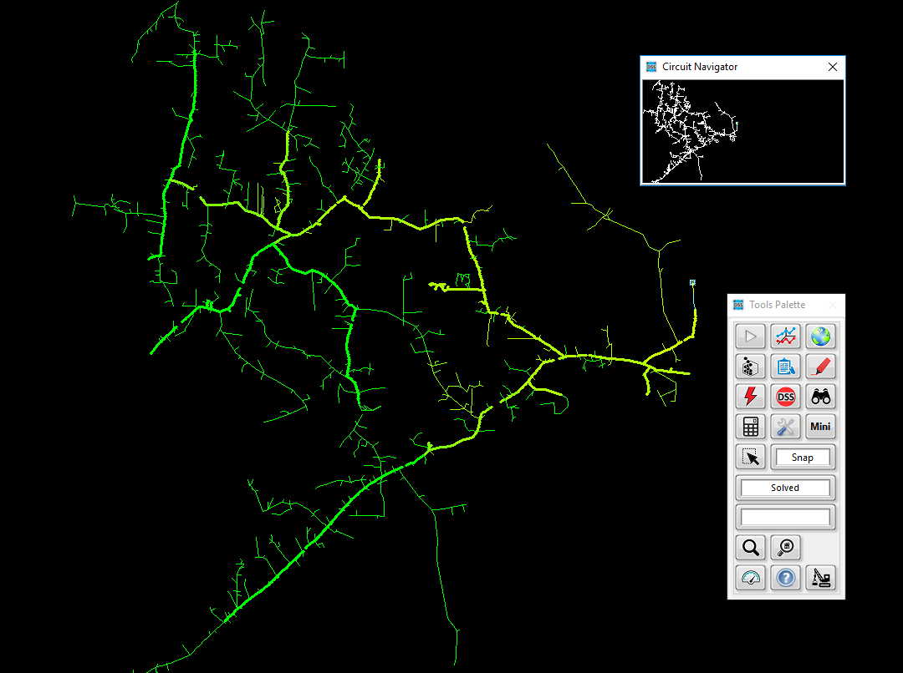
Overview of OpenDSS OpenDSS – Open-Source Distribution System Simulator
Download OpenDSS Here
Advanced distribution analysis platform that enables engineers to perform complex distribution analysis
Flexible and customizable solution designed specifically to meet the challenges facing distribution engineers
Enables engineers to easily model both traditional and advanced distribution technologies, resources, assets, and controls
Leveraged throughout the industry for modeling and simulating advanced distribution applications
Designed from the beginning to capture the time and spatial affects of distributed energy resources
Brief history and current usage
Developed/designed in 1997 to capture the time and spatial affects of distributed energy resources
Open-sourced in 2008 to coordinate and advanced smart grid assessments
Primary modeling and simulation platform used to enable execution of cutting-edge research
Notes:
OpenDSS – EPRI’s best kept secret. ☺

Slide 7
Highlighting a Few Capabilities
Grid Devices
Quasi-static time-series (QSTS)
Full library of traditional assets (lines, conductors, transformers, cap banks, switches, etc.)
Line Reg/LTC, cap banks
DER smart inverter
Solution Capabilities
Unbalanced multi-phase power flow
Fault analysis
Harmonic analysis
Controls
Energy storage dispatch
DMS/DERMS
VVO
Load models
Linear and non-linear analysis
Stray voltage/current analysis
Price modeling/dispatch
Flicker analysis
Automation
Distribution automation
Load transfers
FLISR (Fault Location, Isolation, and Service Restoration)
Solution Interfaces
Parallel processing using actors
Fast power flow
Smart inverters
Energy storage
PV systems
Wind systems
Demand response
Microgrids
DER short-ckt
Misc
Radial and networked systems
Transmission and distribution modeling
Arbitrary sized systems (single feeder to planning area)
Multithreading circuit processing
Multi-core management
DER Models
Distribution System Scripting language
Full graphical user-interface
Co-simulation capabilities
Integrated SDK for customized development
High-Performance Solutions
Notes:
Three main points
1. Wide range of capabiliites
Highlight main points
These have been added through many years of research-driven needs
2. A few we are going to be able to show
3. Some we are not:
- Distribution system scripting language
<Extra not to be discussed>
EPRI R&D and other industry partners (National Labs, universities) continue to advance the tool
Advanced capabilities fully vetted through years of user application
User-minded approach to modeling
All modeling capabilities have and continue to be developed through the years with two things in mind:
Application: How can system models/solutions be created to answer the question/issue at hand
User: how can this be modeled to enable ease of use, but flexible enough for customized analysis

Slide 8
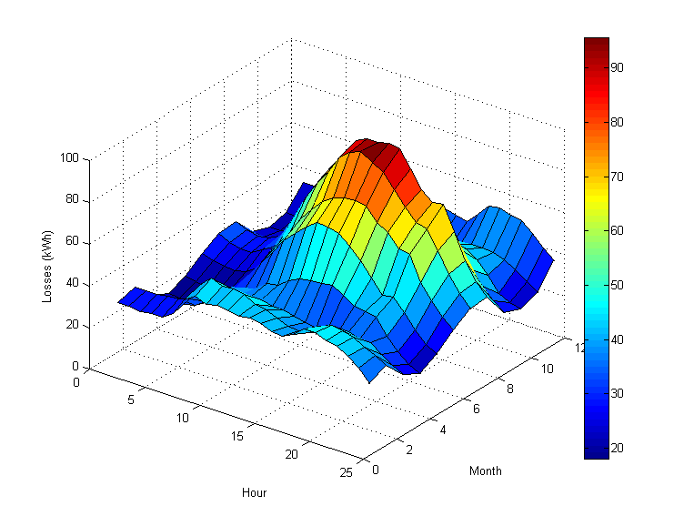
Flexible Tool Enabling a Wide Range of Analysis Types
DER Interconnection studies
Locational value studies
Hosting capacity studies
DA/FLISR scheme evaluation
Volt/var optimization
Energy impact analysis
DER protection impacts
Power quality (harmonics/flicker)
Long-range planning studies
Smart inverter control optimization
Planning for electrification
Notes:
Why do some of these things matter to you and ADP?
- Strength of DSS is it’s w

Slide 9
Typical North American Distribution System
Typical 4-wire multi-grounded neutral system
Unigrounded/Delta 3-wire also common on West Coast

Slide 10
Typical European Style System
3-wire unigrounded primary
Three-phase throughout,
including secondary (LV)

Slide 11
Why a Positive Sequence Model is Often Inadequate for Distribution System Analysis of North American System
Delta-Wye Transformer with Neutral Reactor
Open-Delta Regulator
1-Phase Loads
Blown Capacitor Fuse

Slide 12
Urban Low-Voltage Network Systems

Slide 13
What is the OpenDSS?
Script-driven, frequency-domain electrical circuit simulation tool
Nodal Admittance formulation
Specific models for:
Supporting utility distribution system analysis
Designed for the unbalanced, multi-phase North American power distribution systems
As well as European-style systems
These typically have a simpler structure

Slide 14
What can OpenDSS be used for?
Simple power flow (unbalanced, n-phase)
Daily loading simulations
Yearly loading simulations
Duty cycle simulations
Impulse loads
Rock crushers
Car crushers
Renewable generation
DG
Interconnection studies/screening
Value of service studies (risk based)
Solar PV voltage rise/fluctuation
Wind power variations impact
Hi-penetration solar PV impacts
Harmonic distortion
Dynamics/islanding

Slide 15
What is the OpenDSS? (cont’d)
Heritage
Harmonics solvers rather than power flow
Gives OpenDSS extraordinary distribution system modeling capability
Simpler to solve power flow problem with a harmonics solver than vice-versa
Supports all rms steady-state (i.e., frequency domain) analyses commonly performed for utility distribution system planning
And many new types of analyses
Original purpose: DG interconnection analysis

Slide 16
What is the OpenDSS? (cont’d)
What it is NOT:
An Electromagnetic transients solver (Time Domain)
It can solve Electromechanical transients
Frequency Domain => “Dynamics”
All solutions are in phasors (complex math)
Not a Power Flow program
Not a radial circuit solver
Does meshed networks just as easily
Not a distribution data management tool
It is a simulation engine designed to work with data extracted from one or more utility databases

Slide 17
Built-in Solution Modes
Snapshot (static) Power Flow
Direct (non-iterative)
Daily mode (default: 24 1-hr increments)
Yearly mode (default 8760 1-hr increments)
Duty cycle (1 to 5s increments)
Dynamics (electromechanical transients)
Fault study
Monte carlo fault study
Harmonic
Custom user-defined solutions

Slide 18
User Interfaces
A stand-alone executable program that provides a text-based interface (multiple windows)
An in-process COM server (for Windows) that supports driving the simulator from user-written programs.
A direct DLL interface that mimics the COM interface
For non-Windows platforms, such as HPCs
For programming languages that do not support COM or are not efficient at supporting COM

Slide 19
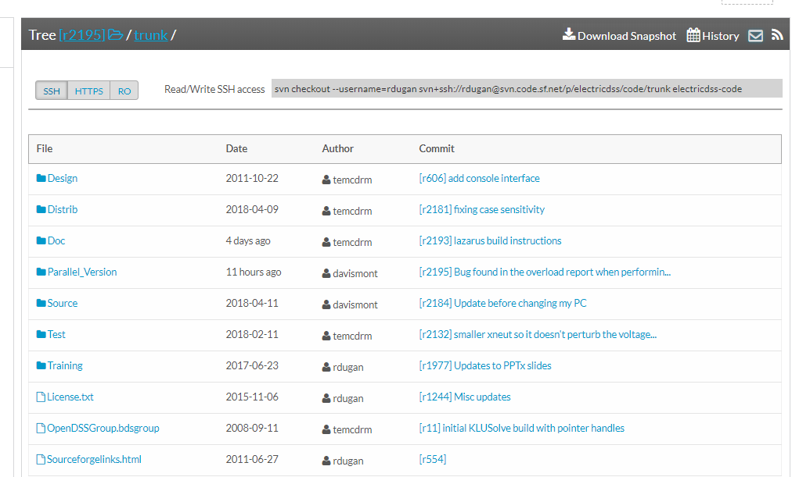
Repository on SourceForge.Net

Slide 20
Accessing the SourceForge.Net Source Code Repository with TortoiseSVN
Install a TortoiseSVN client from Tortoisesvn.net/downloads.
Recommendation:
Then, to grab the files from SourceForge by: 1 - create a clean directory such as "c:\opendss" 2 - right-click on it and choose "SVN Checkout..." from the menu 3 - the repository URL is
http://electricdss.svn.sourceforge.net/svnroot/electricdss
(Change the checkout directory if it points somewhere other than what you want.)
Thereafter, to update a folder or file, right-click on the folder or file and select SVN Update

Slide 21
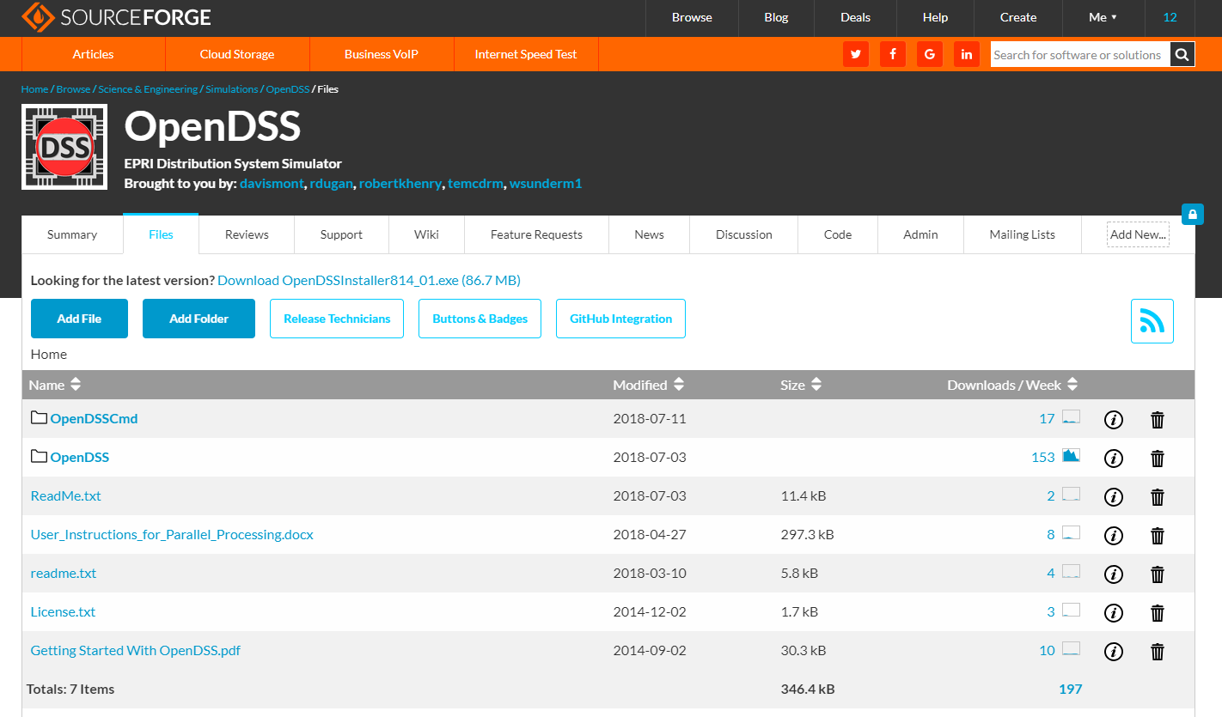
Download the Installer Files

Slide 22
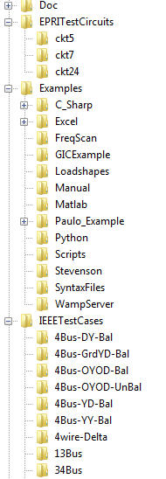
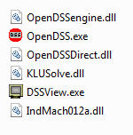
OpenDSS Files Installed
Main Program Files
In-Process COM Server
Standalone EXE
Stdcall DLL

Slide 23
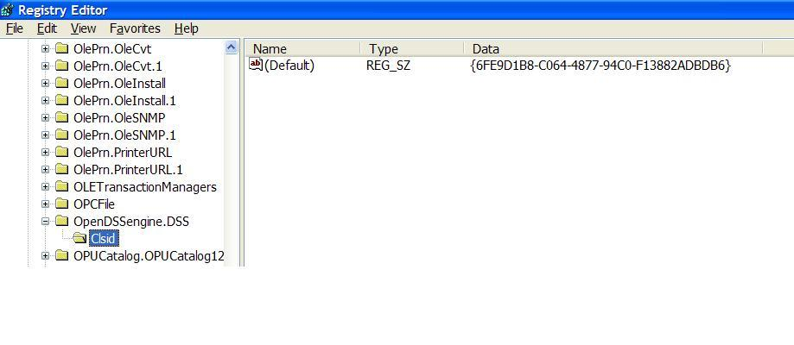
Registering the COM server
Windows Registry Entry
GUID
The Server shows up as “OpenDSSEngine.DSS” in the Windows Registry
The OpenDSS is now available to any program on the computer

Slide 24
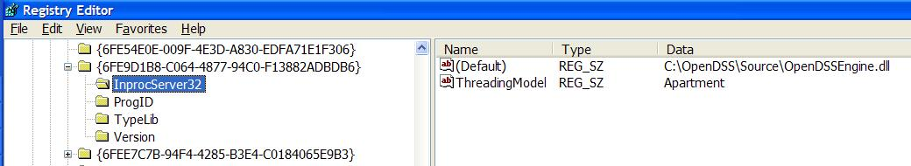
The GUID References the DLL File
If you look up the GUID in RegEdit
Points to OpenDSSEngine.DLL (In-process server, Apartment Threading model)

Slide 25
DSS Structure
Scripts
Main Simulation Engine
COM Interface
User-Written DLLs
Scripts, Results

Slide 26
DSS Object Structure
DSS Executive
Commands
Options
Circuit
Solution
V
[Y]
I
PDElement
PCElement
Controls
Meters
General
Line Transformer Capacitor Reactor
Load Generator Vsource Isource Storage
RegControl CapControl Relay Reclose Fuse
Monitor EnergyMeter Sensor
LineCode LineGeometry WireData LoadShape GrowthShape Spectrum TCCcurve XfmrCode

Slide 27
DSS Class Structure
Instances of Objects of this class
Class
Object 1
Property Definitions
Property Values
Methods
Class Property Editor
Yprim
Collection Manager
States
Object n
Property Values
Methods
Yprim
States

Slide 28
The Math …
Nearly everything results in a matrix or array
Nodal Admittance formulation
Circuit elements modeled by primitive admittance matrices
Y_{prim}
Primitive Y matrices used to build System Y matrix
OpenDSS Works In
Phase domain
Actual volts and amps
Symmetrical components and per units are not used inside the program !! -- Input and output only!

Slide 29
Primitive Y Matrix
Simple Resistor

Slide 30
Primitive Y Matrix, cont’d
LINE model

Slide 31
What about 3-phase elements?
Simply let R, X, B, G, C, etc. represent 3x3 matrix
Notation stays the same
And it works!
I1, I2, V1, V2 etc become 3x1 vectors
This is basically how all the Circuit Element (CktElement) models in OpenDSS work.

Slide 32
The Network Model

Slide 33
Load (a PC Element)
General Concept
Added into Injection Current Vector
Goes into System Y Matrix
(One-Line Diagram)
Most Power Conversion (PC) Elements are Modeled Like This

Slide 34
Nodal Admittance Equations
V₁
V₂
…
V_{S}
…
V_{L1}
…
V_{L2}
…
V_{N}
I₁
I₂
…
I_{S}
…
I_{L1}
…
I_{L2}
…
I_{N}
Y_{SYSTEM}
=
N x N
(Sparse)
N = Number of NODES (not BUSES)

Slide 35
Load Models (Present version)
1:Standard constant P+jQ load. (Default)
2:Constant impedance load.
3:Const P, Quadratic Q (like a motor).
4:Nominal Linear P, Quadratic Q (feeder mix). Use this with CVRfactor.
5:Constant Current Magnitude
6:Const P, Fixed Q
7:Const P, Fixed Impedance Q
8: Special ZIP load model

Slide 36
Standard P + jQ Load Model (1)
Const Z
105%
(Defaults*)
|I| = |S/V|
95%
Almost Linear
Const Z (linear)
New Method (2014)
* Change by setting Vminpu and Vmaxpu Properties

Slide 37
Power Flow Solution Algorithm
Initial Guess at Node Voltages, V
Compute all Injection (Compensation) Currents, I
For PC Elements
Solve for new guess at V
Repeat 2 and 3 until Converged
Convergence is based on per unit change in voltage magnitude
Default tolerance = 0.0001
Good enough for most distribution systems

Slide 38
Putting it All Together
ALL Elements
Yprim 1
Yprim 2
Yprim 3
Yprim n
PC Elements Comp. Currents
I1
I2
Y
Node
Voltages
I_{inj}
=
V
Im
Iteration Loop

Slide 39
Putting it All Together
Th-Th-That's All Folks !
ALL Elements
Yprim 1
Yprim 2
Yprim 3
Yprim n
PC Elements Comp. Currents
I1
I2
Y
Node
Voltages
I_{inj}
=
V
Im
Iteration Loop

Slide 40
A More Concise Form …
Fixed-point solution form for normal solution
V_{n+1} = [Y_{system}]⁻¹ I_{PC}(V_{n}) n = 0, 1, 2, …
… until converged
I_{PC}(V) = compensation currents from Power Conversion (PC) elements in the circuit as a function of voltage

Slide 41
OpenDSS Solution Loop with Controls
Controls are sampled and executed after a converged power flow solution
Power Flow Solution

Slide 42
Circuit Modeling Basics

Slide 43
DSS Bus Model (Bus ≠ Node)
Nodes
Bus
Referring to Buses and Nodes (A Bus has 1 or more Nodes)
Bus1=BusName.1.2.3.0
(This is the default for a 3-phase circuit element)
Shorthand notation for taking the default:
Bus1=BusName
Note: Sometimes this can bite you (e.g. – Transformers, or capacitors with ungrounded neutrals)

Slide 44
Node Numbers
Bus
The voltage at Node 0 = 0 (always)
The other Node numbers are arbitrary
By convention, Nodes 1, 2, 3 correspond to phase ABC
But they don’t have to
You can have a very large number of nodes at a Bus
They do not have to be pre-declared

Slide 45
DSS Terminal Definition
Conductors
Circuit Elements have one or more Terminals with 1..N conductors.
Conductors connect to Nodes at a Bus
Each Terminal connects to one and only one Bus

Slide 46
Power Delivery Elements
PD Elements are Generally Completely Described by [Yprim]

Slide 47
Power Conversion Elements
I_{Term}(t) = F(V_{Term}, [State], t)
Power Conversion (PC) elements are typically connected in “shunt” with the Power Delivery (PD) elements
PC Elements may be nonlinear
Described some function of V
May be linear
e.g., Vsource, Isource
May have more than one terminal, but typically one
Load, generator, storage, etc.

Slide 48
Scripting Basics

Slide 49
Scripting
OpenDSS is a scriptable solution engine
Scripts
Series of commands
From text files
From edit forms in OpenDSS.EXE
From another program through COM interface
e. g., This is how you would do looping
Scripts define circuits
Scripts control solution of circuits
Scripts specify output, etc.

Slide 50
Command Syntax
Command parm1, parm2 parm3 parm 4 ….
Parameters may be positional or named (tagged).
If named, an "=" sign is expected.
Name=value (this is the named form)
Value (value alone in positional form)
For example, the following two commands are equivalent:
New Object="Line.First Line" Bus1=b1240 Bus2=32 LineCode=336ACSR, …
New “Line.First Line”, b1240 32 336ACSR, …
Comma or white space

Slide 51
Delimiters
Array or string delimiter pairs: [ ] , { },( ),“ “,‘ ‘
Matrix row delimiter: |
Value delimiters: , (comma) any white space (tab or space)
Class, Object, Bus, or Node delimiter: . (period)
Keyword / value separator: =
Continuation of previous line: ~ (More)
Comment line: //
In-line comment: !
Query a property: ?

Slide 52
Array and Matrix Parameters
Array
kvs = [115, 6.6, 22]
kvas=[20000 16000 16000]
Matrix
(3x3 matrix)
Xmatrix=[1.2 .3 .3 | .3 1.2 3 | .3 .3 1.2]
(3x3 matrix – lower triangle)
Xmatrix=[ 1.2 | .3 1.2 | .3 .3 1.2 ]

Slide 53
A Basic Script
Clear
New Circuit.Simple ! Creates voltage source (Vsource.Source)
Edit Vsource.Source BasekV=115 pu=1.05 ISC3=3000 ISC1=2500 !Define source V and Z
New Transformer.TR1 Buses=[SourceBus, Sub_Bus] Conns=[Delta Wye] kVs= [115 12.47]
~ kVAs=[20000 20000] XHL=10
New Linecode.336ACSR R1=0.058 X1=.1206 R0=.1784 X0=.4047 C1=3.4 C0=1.6 Units=kft
New Line.LINE1 Bus1=Sub_Bus Bus2=LoadBus Linecode=336ACSR Length=1 Units=Mi
New Load.LOAD1 Bus1=LoadBus kV=12.47 kW=1000 PF=.95
Solve
Show Voltages LN Nodes
Show Currents Element
Show Powers kVA Elements
(You can Copy and Paste this into OpenDSS.EXE

Slide 54
Example: IEEE 8500-Node Test Feeder
– an example of a large circuit

Slide 55
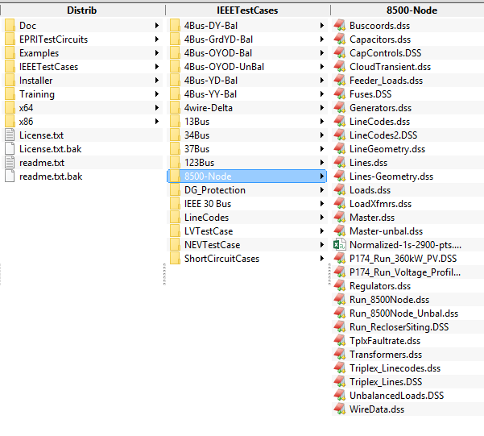
Location of the IEEE 8500-Node Test Feeder Files

Slide 56
Scripting Large Circuits
For small circuits, it is often sufficient to put all the scripts in a single file
Many of the IEEE test feeder examples are mostly in a single file
When you have large amounts of data, a more disciplined approach is recommended
Redirect Command
Redirects the input to another file
Returns to home directory
Compile Command
Same as Redirect except repositions home directory

Slide 57
A Common Sense Structuring of Script Files
Run_The_Master.DSS
“Compile” the Master file from here
Master.DSS
LineCodes.DSS
WireData.DSS
LineGeometry.DSS
Libraries
Put a “Clear” in here
(Clearall for parallel processing)
Spectrum.DSS
LoadShape.DSS
Transformers.DSS
Lines.DSS
Circuit Definition
Make a separate folder for each circuit
Loads.DSS
Etc.

